Slide 1
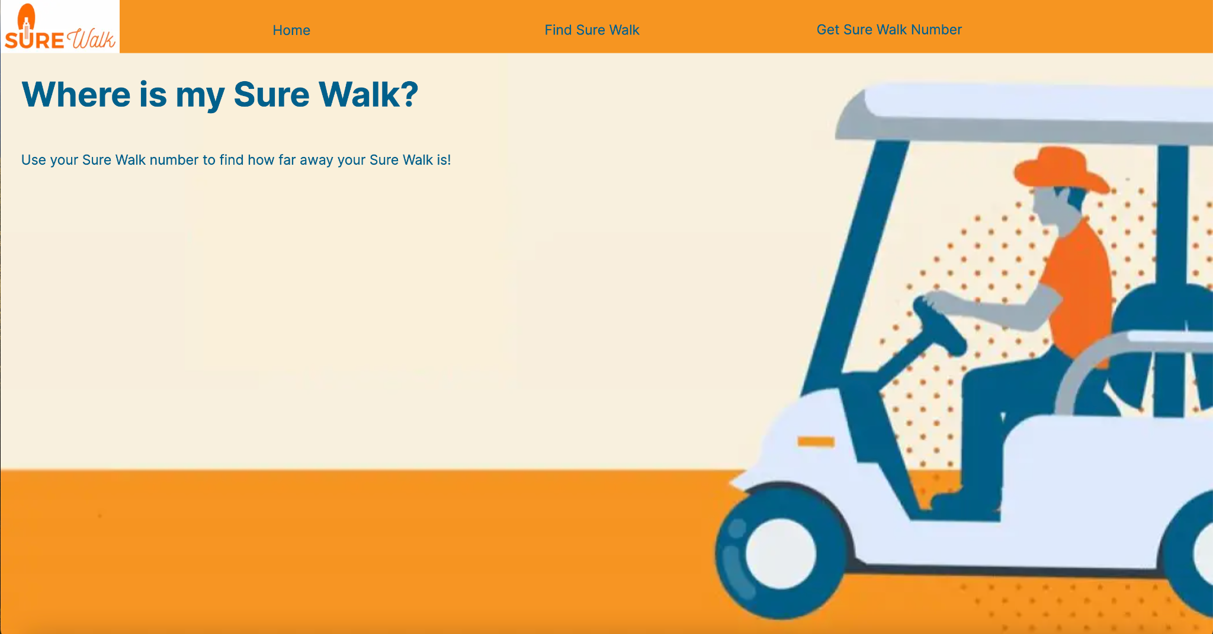
By: Tejaswi Thapa and Hima Tummalapalli
Notes:
Hi, my name is Teja - and my name is Hima - and we are Where is my Sure Walk?

Slide 2

What About Sure Walk?
What is it?: A service for UT students who are trying to get around campus at late hours
What’s the problem?: Unpredictable arrival times
The Solution: “Where’s My Sure Walk?”!
Notes:
Sure Walk is a UT service that provides walks or rides to students who are on campus late. A major problem with Sure Walk is the unpredictable arrival times. Their current system of calling students with an approximate ETA is typically inaccurate and unreliable, causing students to forego using the service entirely. So our solution is Where’s My Sure Walk. This platform allows students to track their assigned Sure Walk in real time using its associated ID number. We designed this platform with the goal of improving the usability of Sure Walk, encouraging student usage and student safety.
Now we will play a demo of our app.

Slide 3


Slide 4

How Did We Make the App?
Tech: Next.js
React-based framework
Easy implementation of page navigation
Potential use of API Routing Feature
Challenges
Limited web development knowledge
Switch from React to Next.js during development
Notes:
Some of the challenges we faced are limited web development knowledge and since we started with React, a mid-development switch to Next.js for the reasons Hima just explained.

Slide 5
What Next?
Edits:
Cleaner UI
More user friendly
Conform more to UT’s brand and style
Cleaner code
Remove inline styles
Comments
More reusability
Additions/Future Plans:
API and Database
Work with Sure Walk
Sure Walk numbers
Enabling Tracking
Testing
Security Features
Hosting
Notes:
Work with Sure Walk to get connection to their data – sign ups, van and walker information
Need to implement Sure Walk number generation once a Sure Walk is scheduled for pickups
Tracking – potentially using the Geolocation API
Testing
Frontend – selenium, jest
Backend unit tests depending on tech stack
Security measures for privacy concerns – login with UT EID + Duo push like other UT sites, Amazon Cognito?
Hosting
Frontend – AWS Amplify
Backend depends on technology used
If data is structured – maybe using Supabase
If data is unstructured – could use Firebase or AWS DynamoDB

Slide 6
Major Sources Used
https://www.w3schools.com/
https://getbootstrap.com/
https://nextjs.org/

